Slide 1

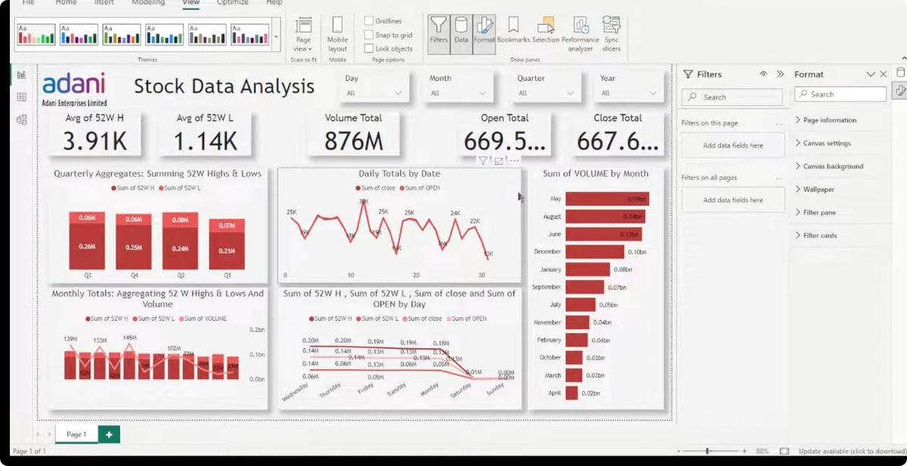
Stock Data Analytics Project
By Harshit Mali
This presentation details the Stock Data Analytics project.
We will cover the project's working and features.
Also, we will explore real-life problems it solves.
Hm
by Harshit mali

Slide 2
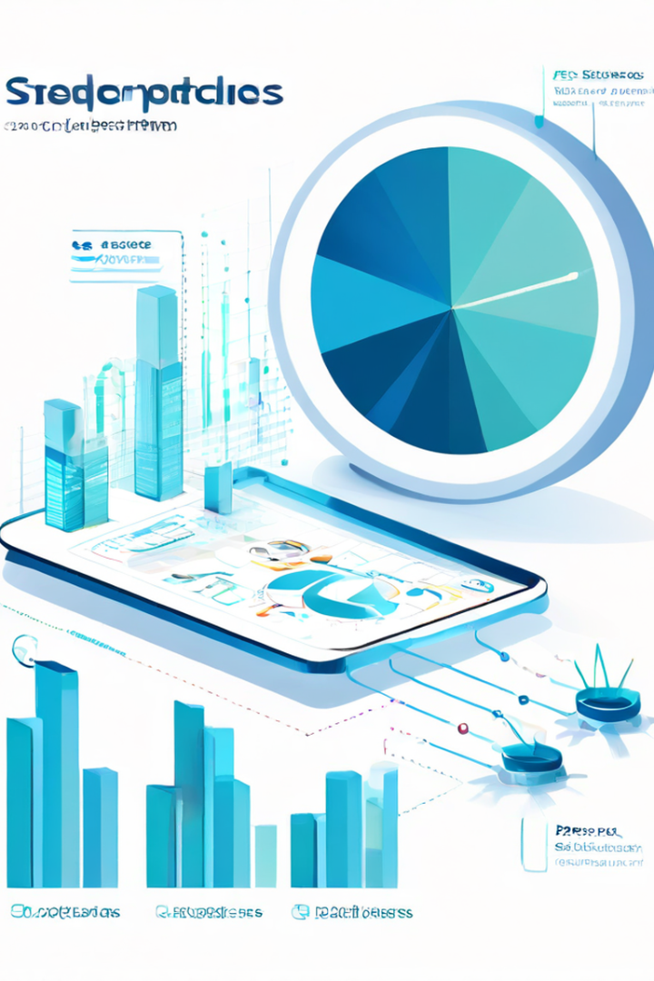




Project Working Overview
Data Collection
Gathering stock data from diverse sources.
Data Processing
Cleaning and transforming the collected data.
Data Analysis
Applying algorithms to identify patterns.
Visualization
Presenting insights via charts and graphs.

Slide 3





Feature Highlights
Real-time Data
Advanced Search
Custom Filters
Up-to-the-minute stock information.
Quickly find specific stock details.
Tailor data views based on criteria.
Alert Notifications
Get notified on key stock movements.

Slide 4

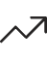

Problem 1: Predicting Market Trends
Trend Analysis
Historical Data
Identifies potential bullish or bearish trends.
Leverages past data for accurate predictions.

Slide 5
Problem 2: Identifying Risky Stocks
Risk Assessment
Alert System
Flags stocks with high volatility.
Provides immediate alerts.
Evaluates financial ratios
Analyzes market sentiment

Slide 6



Problem 3: Optimizing Investment Portfolios
Risk Tolerance
2
Align with investor's profile.
Diversification
1
Spread investments across sectors.
Performance
3
Monitor and rebalance regularly.

Slide 7

Problems 4 & 5: Spotting Opportunities & Reducing Fraud
Opportunity Detection
Find undervalued stocks with growth potential.
Fraud Reduction
Detect anomalies indicative of fraudulent activity.

Slide 8

Thank You
Thank you for your time.
We hope you found this presentation insightful.

